Slide 1
Long Division Standard Algorithm Lesson

Slide 2
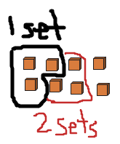
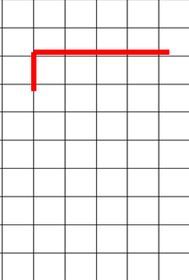
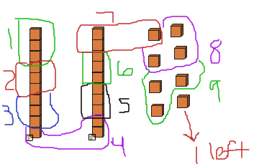
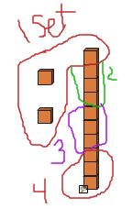
Mill Elementary has 3 times as many students as Hall Elementary. If Mill has 882 students, about how many students attend Hall?
Steps | Model | Long Division
1 | Divide: “How many sets of _______ (divisor) can be pulled from ________ (dividend)” Multiply: “ _______ sets of ________ (divisor) equals the number I subtract.” Subtract: “ Lets pull out _______ from the dividend we are working with
2 | Bring down: “ Bring down the next place value.” Divide: “How many sets of _______ (divisor) can be pulled from ________ (dividend)” Multiply: “ _______ sets of ________ (divisor) equals the number I subtract.” Subtract: “ Lets pull out _______ from the dividend we are working with
3 | Bring down: “ Bring down the next place value.” Divide: “How many sets of _______ (divisor) can be pulled from ________ (dividend)” Multiply: “ _______ sets of ________ (divisor) equals the number I subtract.” Subtract: “ Lets pull out _______ from the dividend we are working with
2
h
3
2
h
t
o
8 8 2
- 6
2
2
h
9
t
o
3
8 8 2
- 6
2
8
- 2 7
0 1
2
h
9
t
o
3
8 8 2
- 6
2
8
- 2 7
0 1
2
- 1 2

Slide 3
Mill Elementary has _____ times as many students as Hall Elementary. If Mill has______students, about how many students attend Hall?
Steps | Model | Long Division
1 | Divide: “How many sets of _______ (divisor) can be pulled from ________ (dividend)” Multiply: “ _______ sets of ________ (divisor) equals the number I subtract.” Subtract: “ Lets pull out _______ from the divisor we are working with
2 | Divide: “How many sets of _______ (divisor) can be pulled from ________ (dividend)” Multiply: “ _______ sets of ________ (divisor) equals the number I subtract.” Subtract: “ Lets pull out _______ from the divisor we are working with
3 | Divide: “How many sets of _______ (divisor) can be pulled from ________ (dividend)” Multiply: “ _______ sets of ________ (divisor) equals the number I subtract.” Subtract: “ Lets pull out _______ from the divisor we are working with

Slide 4
Mill Elementary has 5 times as many students as Hall Elementary. If Mill has 535 students, about how many students attend Hall?
Steps | Model | Long Division
1 | Divide: “How many sets of _______ (divisor) can be pulled from ________ (dividend)” Multiply: “ _______ sets of ________ (divisor) equals the number I subtract.” Subtract: “ Lets pull out _______ from the divisor we are working with
2 | Divide: “How many sets of _______ (divisor) can be pulled from ________ (dividend)” Multiply: “ _______ sets of ________ (divisor) equals the number I subtract.” Subtract: “ Lets pull out _______ from the divisor we are working with
3 | Divide: “How many sets of _______ (divisor) can be pulled from ________ (dividend)” Multiply: “ _______ sets of ________ (divisor) equals the number I subtract.” Subtract: “ Lets pull out _______ from the divisor we are working with

