Slide 1
Mrs.
Mayweather’s
Classroom
Expectations

Slide 2
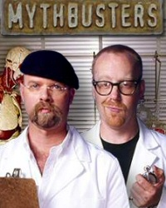
Pre-test:
Do you think these are facts or myths?
In our class, you only represent yourself.
You should always work to your best potential!
It does not matter how you sit or stand.
A great teammate always has someone else’s back.
Morning Arrival and afternoon dismissal are a time to talk!
If you finish early, you should read a book, finish work from earlier, or write in your journal.
Your notebook does not have to be organized, it’s not important.
I should be your first resource if you are confused about something.

Slide 3
In our home…

Slide 4
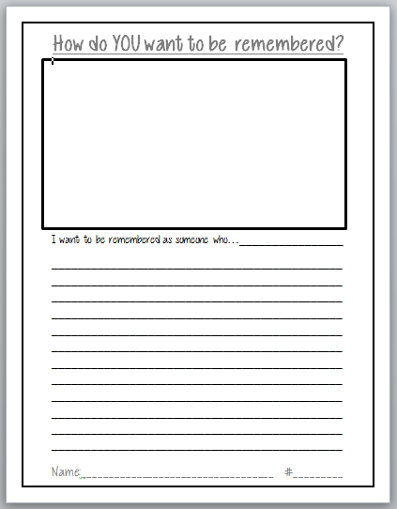
First thing’s first… You represent
MORE than yourself!
You are the window to your family!!!
I want to be remembered as someone who brought out the best in others. I also want people to remember me for the light that I shine when I walk through the door. It is important to me that I take care of others, never be afraid of learning, and always serve for a higher purpose!
How do you want people to remember you?
“I want to be remembered as a person who…” ACTIVITY

Slide 5
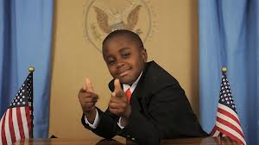
You can TRANSFORM yourself!
Take a little inspiration from my little friend…
The Kid President!

Slide 6
Behavior Expectations!

Slide 7
Attention grabbers!
I will use a few different cues to get your attention! Your goal is to stop immediately!
Scoot – a – loo!
“WHOOOOOP!”
Drum Roll Please!
“duh—dum—cha”
1….2…3…
-look -stand -walk
2 Claps to that!
“Clap -- Clap!”
On my signal, what’s my signal?
“Pop!”
SET THE PACE!
Freeze and focus
Celebrate
“WHOOP WHOOP!”
Super Focus
“SWOOOSH!”

Slide 8
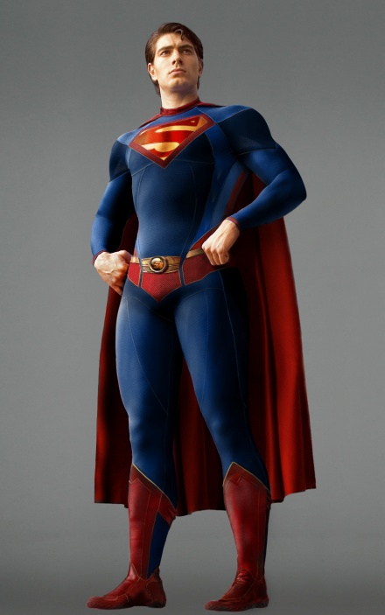
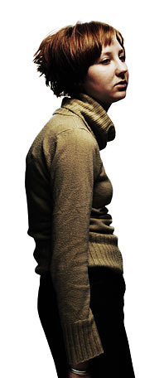
Body Language is important:
Shoulders back, chin up…Be proud of who you are!
How you look is who you are!
Who looks more
confident?

Slide 9
The
7 Habits of Healthy Kids
Video refresher!
Video clip and Dojo behavior sort

Slide 10
Class Dojo
Rewards and
Consequences

Slide 11
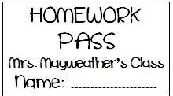
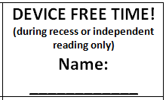
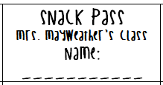
Class Dojo
Prizes and Privileges
Ways to earn a pass or privilege:
DOJO Score of 80% or higher on Fridays (even if not in the top 5)
Random leadership ticket drawing
Random times you impress me with extra effort!

Slide 12
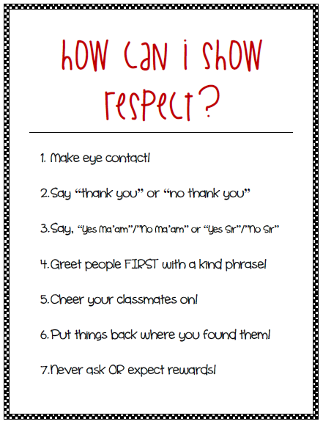
The Best
Ways to show RESPECT!
10 things you should say video
“How to speak Love anchor chart”
“OFF LIMIT WORDS”

Slide 13
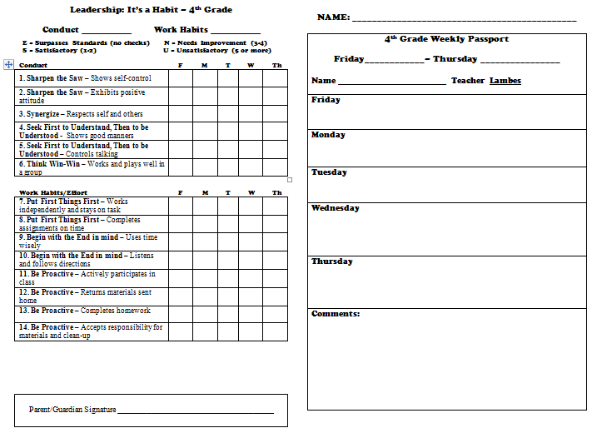
PASSPORTS:
FRIDAY MORNING COMPLETE YOUR NEW PASSPORT

Slide 14
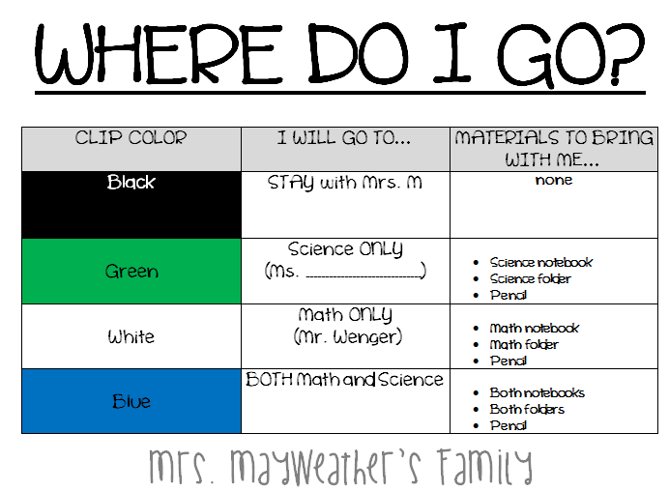
Where do we go clips
Your clip color tells you where to go!

Slide 15
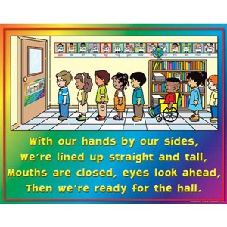
Hallway procedures:
Walking in the hall is a big deal…how we look is what people will think of us. how do you want to represent our class out there?
Line up at the door silently, in an “L” line. Do not leave until dismissed.
Remember, someone is always watching…be a role model at all times!
stay to the right of the hall, Keep your hands to yourself, shoulders back, chin up!
Avoid gaps in the line,
keep up with the pace!
LINE LEADERS: stop at EVERY corner and look back for me. I will signal you to continue walking

Slide 16
Restroom procedures:
You’ll have plenty of chances to go, take advantage of them!
What does my SIGNAL mean?
split into 3 lines,
line up by the restroom when I dismiss you
4 people inside at a time.
Go quickly and quietly, wash your hands, exit fast!
“last call” means you have 30 seconds to join the line outside- those who are tardy will get a negative Dojo point.

Slide 17
Our
Basic Procedures

Slide 18
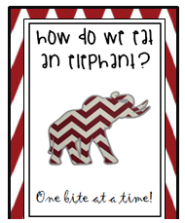
How do we eat an elephant?
One bite at a time!!!
Class jobs descriptions
Practice/trade
Create clips

Slide 19
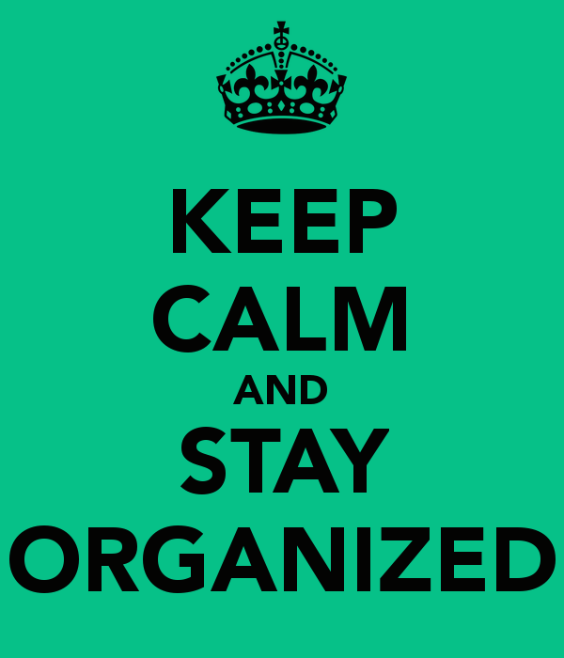
SUPPLIES AND NOTEBOOKS
At your house, you will keep a supply box and book box…
SORT ALL SUPPLIES
BUILD SUPPLY BOXES
BUILD BOOK BOXES
BUILS NOTEBOOKS
.

Slide 20
Review: Attention grabbers!
I will use a few different cues to get your attention! Your goal is to stop immediately!
Scoot – a – loo!
“WHOOOOOP!”
Drum Roll Please!
“duh—dum—cha”
1….2…3…
-look -stand -walk
2 Claps to that!
“Clap -- Clap!”
On my signal, what’s my signal?
“Pop!”
Celebrate
“WHOOP WHOOP!”
Super Focus
“SWOOOSH!”

Slide 21
Class Dojo
Let’s Review Rewards and
Consequences

Slide 22
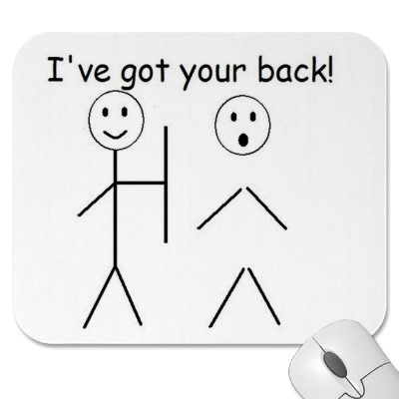
In this classroom…
We are family!
What does a family LOOK like?
Giving high fives!
Patting each other on the back!
Sharing materials!
Opening doors for one another!
Helping each other when we don’t have to!
Trying to play with a new family member outside!
Getting EXCITED when someone else succeeds!
What does a family SOUND like?
“I’ve got your back!”
“I believe in you!”
“I disagree with you because __________”
“I see what you mean, but…”
Family matrix activity and presentations

Slide 23
Morning arrival:
arrival is silent!!!
1st | 2nd | 3rd | 4th
Answer the ticket in the door Get your name clip | GREET ME WITH YOUR EYES AND VOICE! Put away clip and ticket slip in the correct location! | LOOK AT THE MORNING BOARD FOR DIRECTIONS UNPACK ALL ITEMS Submit any money | GO DIRECTLY TO YOUR DESK Fill out agenda Morning work
Demo clip
Demo elephant
Mrs. M is off limits! Submit all questions to my elephant!

Slide 24
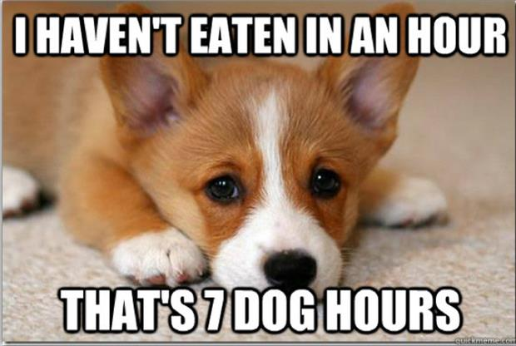
Lunch info:
Lunch money or ice cream money:
during morning work, complete a form, place it in the bin.
IN THE LUNCH ROOM:
wait to be dismissed to get food.
Touch only the food you are taking.
Say thank you to the lunch ladies- make eye contact!
Walk to our table, eat quietly and neatly.
Leave the table cleaner than you found it!
WHEN WE LEAVE, Boys stand and let the ladies leave first.
Demo forms
Practice leaving table

Slide 25
Afternoon dismissal:
Dismissal is silent!!!
Monday - Thursday
2:25 Stack your chair 2:28 Restroom Break 2:35 Enter class 4 @ time * get book bag * pack up materials * sit on your table * Afternoon Mtg. 2:40 Begin jobs
Fridays
2:25 Stack your chair 2:28 Restroom Break 2:35 Enter class 4 @ time * get book bag/F.F. * pack up materials * sit on your table * Afternoon Mtg./Dojo 2:40 Begin jobs

Slide 26
Agenda book:
Update your homework every morning, and keep it organized!
Pass out agendas
Practice recording hmwk.

Slide 27
pencils:
The pencil sharpener is CLOSED during the day.
You have 10 pencils to share at your house.
You may also bring 1 mechanical pencil of your own (keep in your tub)
At the end of the day, there must be 10 pencils in your pencil cup in order to receive a positive point!
The pencil sharpener will:
Collect all pencils at the end of the day
Sharpen only house pencils
Replace 10 pencils at each house
If your pencil breaks…
Trade it for another at your house
Use your mechanical pencil
Use a marker, pen or crayon

Slide 28
Supply shelves:
Keep notebooks, books, folders stacked neatly under your tub
Captains will pass all materials out to you!
Only gather your own materials during independent work
Shelves will be checked for organization and rewards and consequences will be given!

Slide 29
How to head your papers:
Name
#
Date

Slide 30
What do I do if I finish early?
If you finish your work early, you may do any of the following things…
Just remember to stay silent!!!
REFER TO THE EARLY FINISHERS POSTER

Slide 31
If you are absent:
You have a couple of responsibilities…
Bring a note from home → turn it into my basket
Ask me for a missing work folder
Return the folder by the due date I give you!

Slide 32
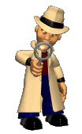
Use before me!
You are fourth graders now…so you must be resourceful! If you get stuck, look for the answer! You’ll most likely find it!
Types of resources CHART:
*can you add to it?
3
Types of resources chart

Slide 33
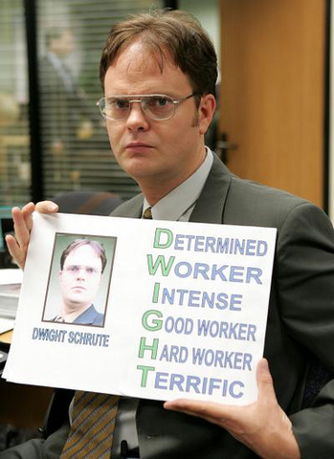
Always remember…
Commit to H.Q.W!
What is H.Q.W?
HIGH…QUALITY…WORK
Can be used as an example for others to see!
It’s CLEAR, NEAT, and WELL ORGANIZED!
Proves you have made GREAT EFFORT and shows your thinking!
Create clips for board

Slide 34
TURNING PAPERS IN:
TURNING INTO THE DRAWERS…
* place all paper in the same direction
TURNING INTO YOUR CAPTAIN
*pass materials to them quickly and quietly
TURNING IN NOTEBOOKS
* open to the page I’m grading
* stack notebooks neatly where I ask you to
Demonstrate all 3
Discuss grading chart

Slide 35
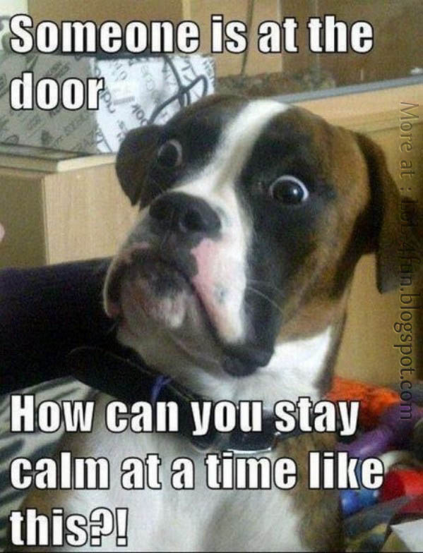
If someone knocks on the door:
* Please do not shout out that someone is here, FOCUS ON ME!
* Upon my approval, the LINE LEADER can open the door!

Slide 36
Moving around the room:
If you must get up, please do so quietly and quickly…no need to doddle!
Also, please be respectful and stay seated if a teacher, classmate, or visitor is talking in front of the class.
Restroom breaks: we will have certain times to go…only go to the restroom if it is an emergency!
Remember to move your name to where you are going on the chart by the door! ☺
DEMONSTRATE I’m gone chart PRACTICE

Slide 37
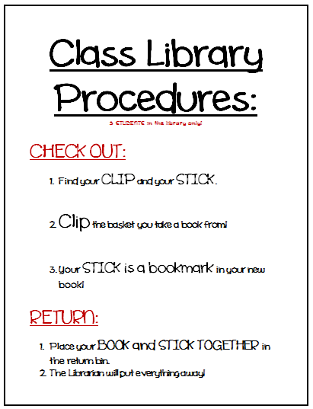
Classroom library:
Class library books must stay in the classroom at all times! No field trips home, please! ☺
Check out times: DURING MORNING WORK ONLY
#1-5 MONDAY
#6-10 TUESDAY
#11-15 WEDNESDAY
#16-20 THURSDAY
#21-25 FRIDAY
Demo and make clips and book marks
Demonstrate and practice

Slide 38
TABLE CHALLENGE
Post-test:
Do you think these are facts or myths?
In our class, you only represent yourself.
You should always work to your best potential!
It does not matter how you sit or stand.
A great teammate always has someone else’s back.
Morning Arrival and afternoon dismissal are a time to talk!
If you finish early, you should read a book, finish work from earlier, or write in your journal.
Your notebook does not have to be organized, it’s not important.
I should be your first resource if you are confused about something.

